Slide 1


Slide 2
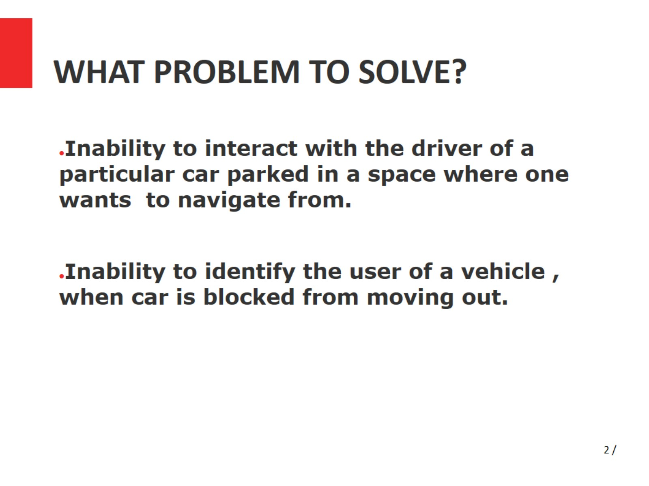
WHAT PROBLEM TO SOLVE?

Slide 3
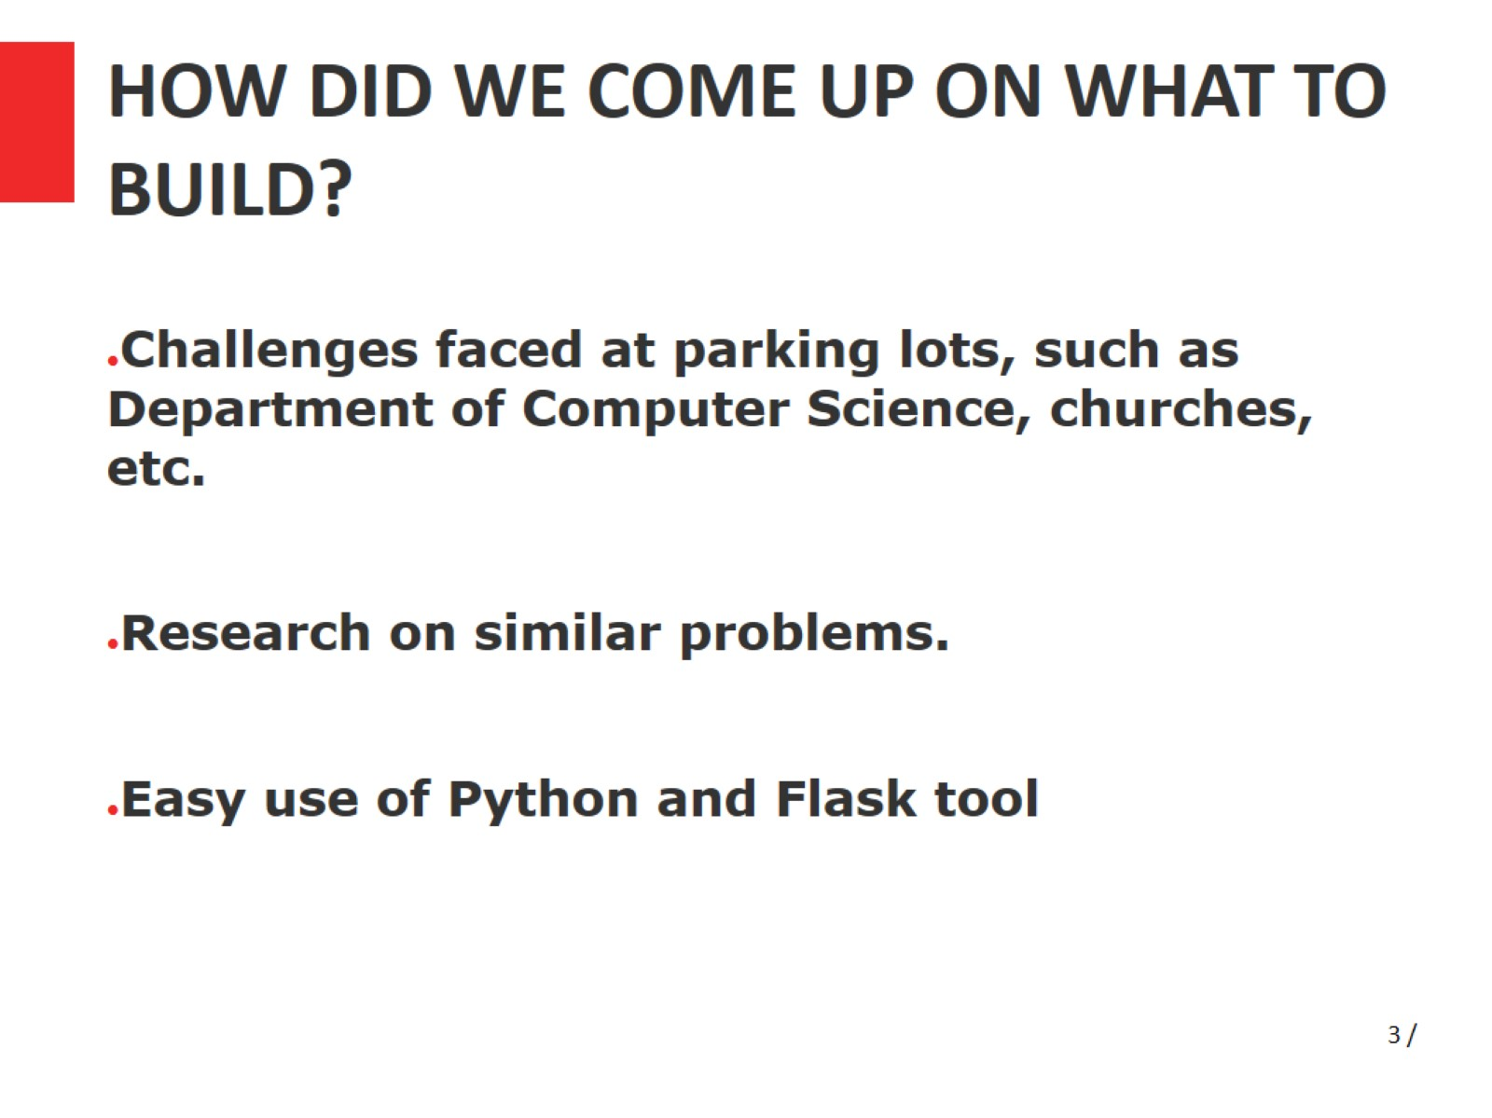
HOW DID WE COME UP ON WHAT TO BUILD?

Slide 4
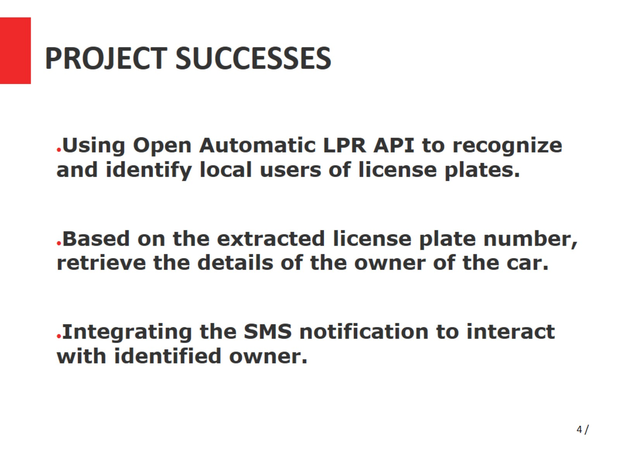
PROJECT SUCCESSES

Slide 5
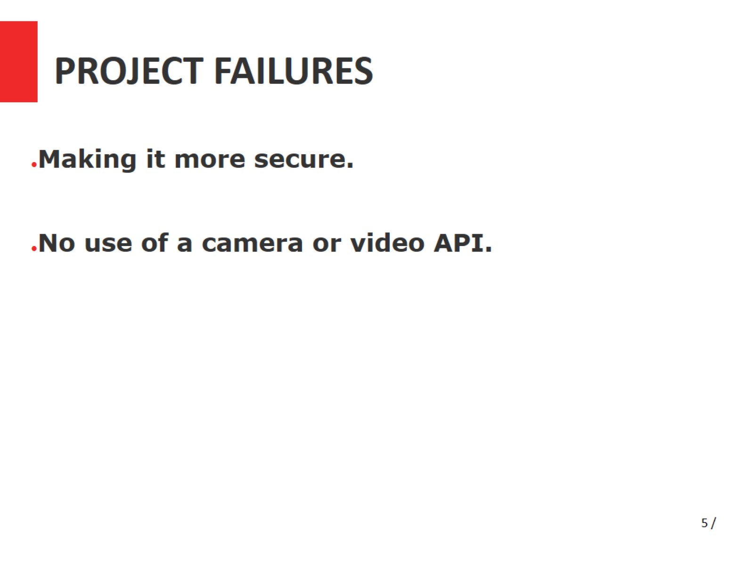
PROJECT FAILURES

Slide 6
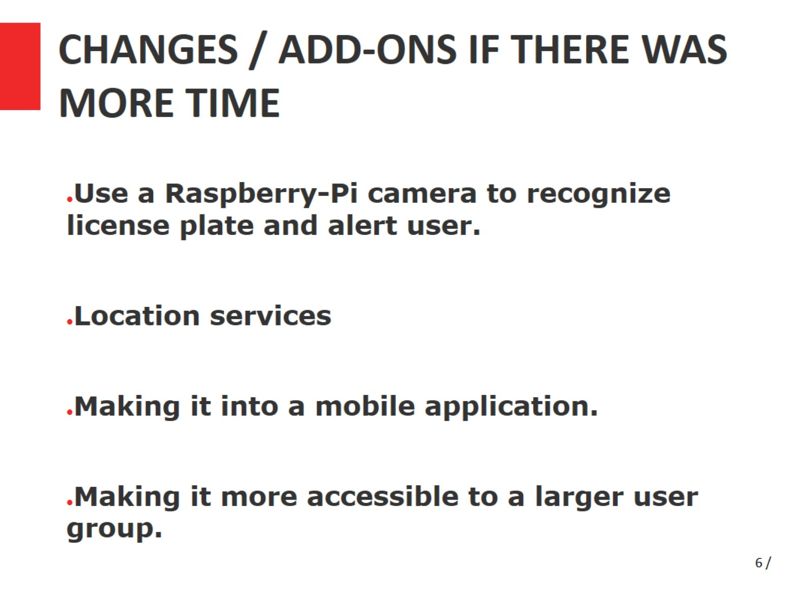
CHANGES / ADD-ONS IF THERE WAS MORE TIME

Slide 7
